Slide 1
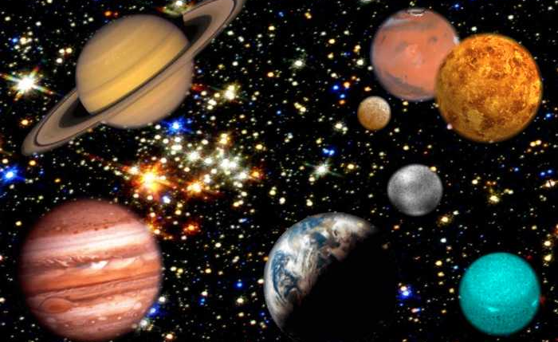
Space
Student: Mariya Kozelets
Teacher: Smirnova Viktoriya

Slide 2
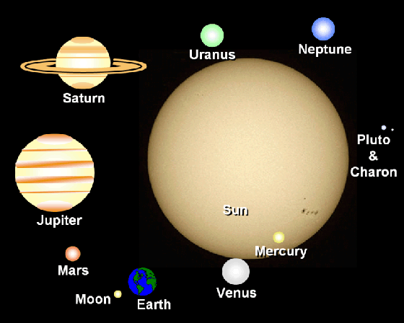
THE SOLAR SYSTEM.
System consists of the Sun and those celestial objects bound to it by gravity, all of which were formed from The Solar the collapse of a giant molecular cloud approximately 4.6 billion years ago. Of the many objects that orbit the Sun, most of the mass is contained within eight relatively solitary planets whose orbits are almost circular and lie within a nearly flat disc called the ecliptic plane.
The four smaller inner planets, Mercury, Venus, Earth and Mars, also called the terrestrial planets, are primarily composed of rock and metal.
The four outer planets, the gas giants, are substantially more massive than the terrestrials. The two largest, Jupiter and Saturn, are composed mainly of hydrogen and helium; the two outermost planets, Uranus and Neptune, are composed largely of ices, such as water, ammonia and methane, and are often referred to separately as "ice giants".

Slide 3
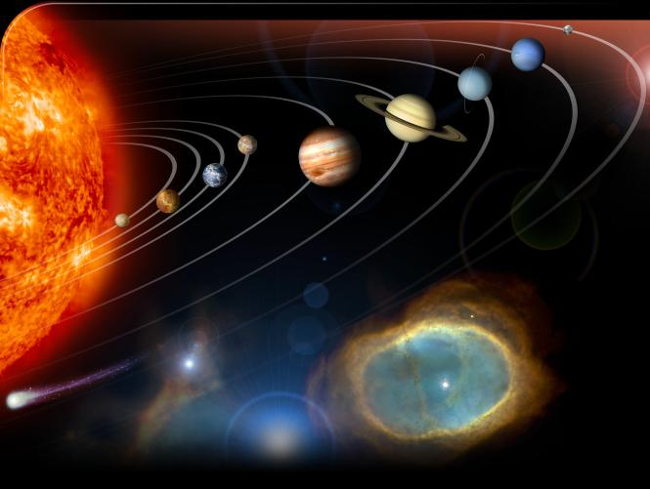
The Solar System is also home to two regions populated by smaller objects. The asteroid belt, which lies between Mars and Jupiter, is similar to the terrestrial planets as it is composed mainly of rock and metal. Beyond Neptune's orbit lie trans-Neptunian objects composed mostly of ices such as water, ammonia and methane. Within these two regions, five individual objects, Ceres, Pluto, Haumea, Makemake and Eris, are recognized to be large enough to have been rounded by their own gravity, and are thus termed dwarf planets
In addition to thousands of small bodies in those two regions, various other small body populations, such as comets, centaurs and interplanetary dust, freely travel between regions.
Six of the planets and three of the dwarf planets are orbited by natural satellites, usually termed "moons" after Earth's Moon. Each of the outer planets is encircled by planetary rings of dust and other particles.

Slide 4
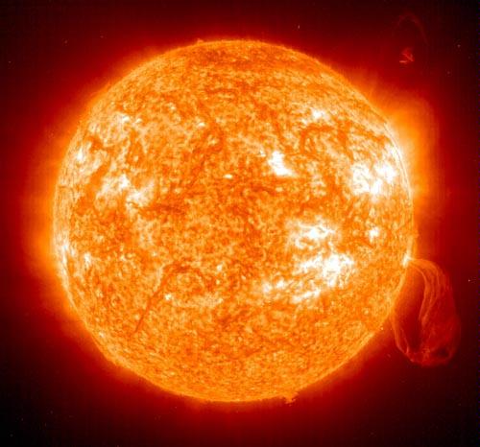
THE SUN
The big burning ball of gas that holds nine major planets in orbit is not unlike many stars in the universe. The Sun makes up 99.86 percent of the solar system's mass and provides the energy that both sustains and endangers us. Scientists have lately begun calling its tremendous outpouring of energy "space weather".
The Sun can be divided into three main layers: a core, a radiative zone, and a convective zone. The Sun's energy comes from thermonuclear reactions (converting hydrogen to helium) in the core, where the temperature is 15 to 25 million degrees. The energy radiates through the middle layer, then bubbles and boils to the surface in a process called convection. Charged particles, called the solar wind, stream out at a million miles an hour

Slide 5
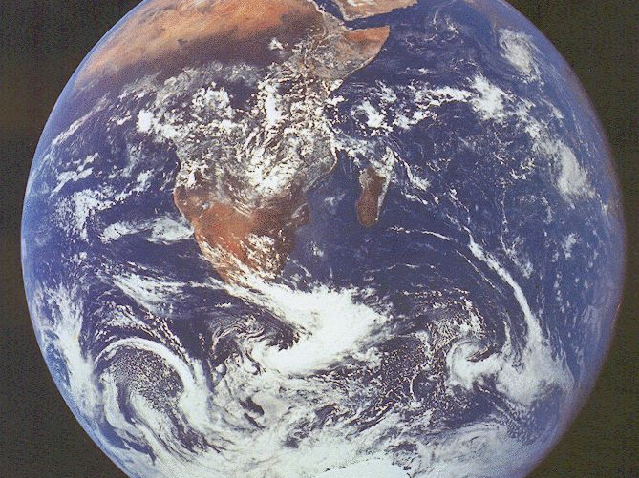
THE EARTH
The third planet from the sun is, in scientific terms, quite similar to the first two. In fact, the four planets of the inner solar system (Mercury, Venus, Earth and Mars) all share rock and metal as their primary ingredients. Each of these so-called terrestrial planets has a solid surface, unlike the gaseous planets of the outer solar system.
Perhaps Earth's most distinguishing factor, at least from our point of view, is the presence of water, which contributed to the formation of life some 3,000 million years ago. Most of us ought also to be fond of Earth's unique atmosphere, rich in life-sustaining nitrogen and oxygen.

Slide 6
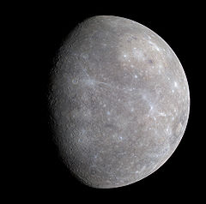
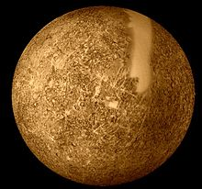
Mercury
Mercury is the innermost and smallest planet in the Solar System, orbiting the Sun once every 87.969 Earth days. Mercury is similar in appearance to the Moon: it is heavily cratered with regions of smooth plains, has no natural satellites and no substantial atmosphere. However, it has a large iron core, which generates a magnetic field about 1% as strong as that of the Earth. Surface temperatures range from about −183 °C to 427 °C.

Slide 7
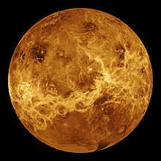
Venus
The second planet from the Sun, orbiting it every 224.7 Earth days. The planet is named after Venus, the Roman goddess of love and beauty. After the Moon, it is the brightest natural object in the night sky. Venus reaches its maximum brightness shortly before sunrise or shortly after sunset, for which reason it has been known as the Morning Star or Evening Star. Venus is classified as a terrestrial planet and it is sometimes called Earth's "sister planet" due to the similar size, gravity, and bulk composition. Venus is covered with an opaque layer of highly reflective clouds of sulfuric acid, preventing its surface from being seen from space in visible light. Venus has the densest atmosphere of all the terrestrial planets in our solar system, consisting mostly of carbon dioxide. A younger Venus is believed to have possessed Earth-like oceans, but these evaporated as the temperature rose. Venus's surface is a dusty dry desert with many slab-like rocks, periodically refreshed by volcanism
The water has most likely dissociated, and, because of the lack of a planetary magnetic field, the hydrogen has been swept into interplanetary space by the solar The CO2-rich atmosphere, along with thick clouds of sulfur dioxide, generates the strongest greenhouse effect in the Solar System, creating surface temperatures of over 460 °C This makes the Venusian surface hotter than Mercury's] even though Venus is nearly twice Mercury's distance from the Sun and thus receives only 25% of Mercury's solar irradiance. The surface of Venus is often said to resemble Hell.

Slide 8
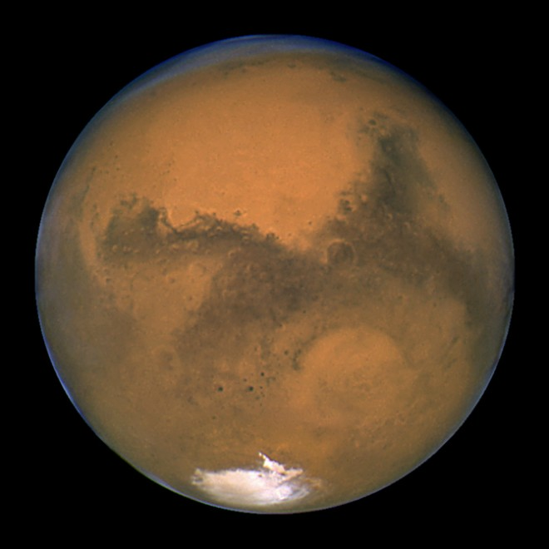
MARS
Mars in astronomy, 4th planet from the sun, with an orbit next in order beyond that of the earth.
Mars has a striking red appearance, and in its most favorable position for viewing, when it is opposite the sun, it is twice as bright as Sirius, the brightest star. Mars has a diameter of 4,200 mi (6,800 km), just over half the diameter of the earth, and its mass is only 11% of the earth's mass. The planet has a very thin atmosphere consisting mainly of carbon dioxide, with some nitrogen and argon. Mars has an extreme day-to-night temperature range, resulting from its thin atmosphere, from about 80°F (27°C) at noon to about -100°F (-73°C) at midnight; however, the high daytime temperatures are confined to less than 3 ft (1 m) above
The greater part of the surface area of Mars appears to be a vast desert, dull red or orange in color. This color may be due to various oxides in the surface composition, particularly those of iron. About one fourth to one third of the surface is composed of darker areas whose nature is still uncertain. Shortly after its perihelion Mars has planetwide dust storms that can obscure all its surface details.

Slide 9
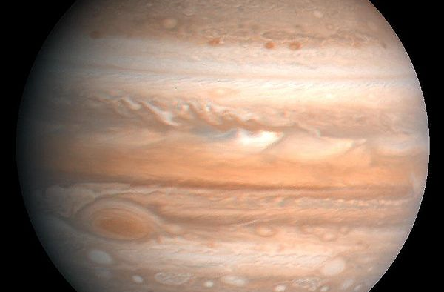
JUPITER
Jupiter is the fifth planet from the Sun and the largest planet within the Solar System. It is a gas giant with a mass slightly less than one-thousandth of the Sun but is two and a half times the mass of all the other planets in our Solar System combined. Jupiter is classified as a gas giant along with Saturn, Uranus and Neptune. Together, these four planets are sometimes referred to as the Jovian planets.
The planet was known by astronomers of ancient times and was associated with the mythology and religious beliefs of many cultures. The Romans named the planet after the Roman god Jupiter. When viewed from Earth, Jupiter on average is the third-brightest object in the night sky after the Moon and Venus.
Jupiter is primarily composed of hydrogen with a quarter of its mass being helium; it may also have a rocky core of heavier elements. The outer atmosphere is visibly segregated into several bands at different latitudes, resulting in turbulence and storms along their interacting boundaries. A prominent result is the Great Red Spot, a giant storm that is known to have existed since at least the 17th century when it was first seen by telescope. Surrounding the planet is a faint planetary ring system and a powerful magnetosphere. There are also at least 63 moons, including the four large moons called the Galilean moons that were first discovered by Galileo Galilei in 1610. Ganymede, the largest of these moons, has a diameter greater than that of the planet Mercury, among others are Europa, and Callisto

Slide 10
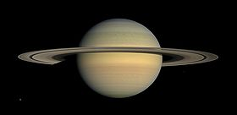
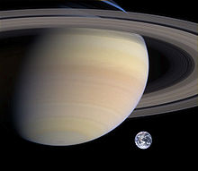
Saturn
The interior of Saturn is probably composed of a core of iron, nickel, silicon and oxygen compounds, surrounded by a deep layer of metallic hydrogen, an intermediate layer of liquid hydrogen and liquid helium and finally, an outer gaseous layer. Electrical current within the metallic-hydrogen layer is thought to give rise to Saturn's planetary magnetic field, which is slightly weaker than Earth's magnetic field
Saturn has nine rings, consisting mostly of ice particles with a smaller amount of rocky debris and dust. Sixty-two known moons orbit the planet; fifty-three are officially named.
The sixth planet from the Sun and the second largest planet in the Solar System, after Jupiter. Saturn is named after the Roman god Saturn, equated to the Greek Cronus (the Titan father of Zeus).
Saturn is classified as a gas giant. Saturn has an average radius about 9 times larger than the Earth's. While only 1/8 the average density of Earth, due to its larger volume, Saturn's mass is just over 95 times greater than Earth's. Because of Saturn's large mass and resulting gravitation, the conditions produced on Saturn are extreme if compared to Earth.

Slide 11
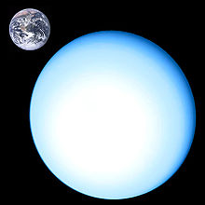
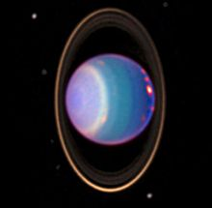
Uranus
The seventh planet from the Sun. It has the third-largest planetary radius and fourth-largest planetary mass in the Solar System. It is named after the ancient Greek deity of the sky Uranus. Uranus's atmosphere, while similar to Jupiter and Saturn's in its primary composition of hydrogen and helium, contains more "ices" such as water, ammonia and methane, along with traces of hydrocarbons. It is the coldest planetary atmosphere in the Solar System, with a minimum temperature of –224 °C. It has a complex, layered cloud structure, with water thought to make up the lowest clouds, and methane thought to make up the uppermost layer of clouds. In contrast the interior of Uranus is mainly composed of ices and rock. Uranus has a ring system, a magnetosphere, and numerous moons.

Slide 12
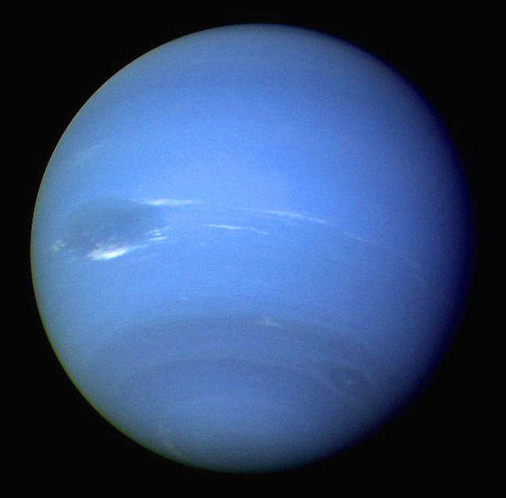
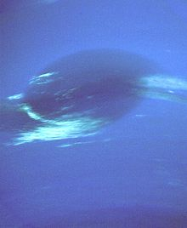
Neptune
The eighth and farthest planet from the Sun in our Solar System. Named for the Roman god of the sea, it is the fourth-largest planet by diameter and the third-largest by mass. On average, Neptune orbits the Sun at a distance of 30.1 AU, approximately 30 times the Earth-Sun distance Astronomers sometimes categorize Uranus and Neptune as "ice giants" in order to emphasize these distinctionsThe interior of Neptune, like that of Uranus, is primarily composed of ices and rock. Traces of methane in the outermost regions in part account for the planet's blue appearance. At the time of the 1989 Voyager 2 flyby, the planet's southern hemisphere possessed a Great Dark Spot. These weather patterns are driven by the strongest sustained winds of any planet in the Solar System, with recorded wind speeds as high as 2,100 km/h. Because of its great distance from the Sun, Neptune's outer atmosphere is one of the coldest places in the Solar System, with temperatures at its cloud tops approaching −218 °C Temperatures at the planet's centre, however, are approximately 5,000 °C

Slide 13
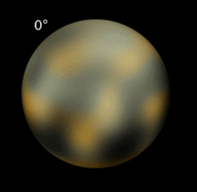
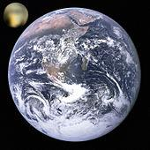
Pluto
From its discovery in 1930 until 2006, Pluto was considered the Solar System's ninth planet. In the late 1970s, following the discovery of minor planet 2060 Chiron in the outer Solar System and the recognition of Pluto's relatively low mass, its status as a major planet began to be questioned. In the late 20th and early 21st century, many objects similar to Pluto were discovered in the outer Solar System, notably the scattered disc object Eris in 2005, which is 27% more massive than Pluto. On August 24, 2006, the International Astronomical Union (IAU) defined what it means to be a "planet" within the Solar System. This definition excluded Pluto as a planet and added it as a member of the new category "dwarf planet" along with Eris and Ceres. After the reclassification, Pluto was added to the list of minor planets and given the number 134340. A number of scientists continue to hold that Pluto should be classified as a planet.

